Slide 1
SVM – Support Vector Machine

Slide 2
Introduction
Support Vector Machine or SVM is one of the most popular Supervised Learning algorithms, which is used for Classification as well as Regression problems. However, primarily, it is used for Classification problems in Machine Learning.
SVMs are different from other classification algorithms because of the way they choose the decision boundary that maximizes the distance from the nearest data points of all the classes. It can easily handle multiple continuous and categorical variables. SVM constructs a hyperplane in multidimensional space to separate different classes.
SVM generates optimal hyperplane in an iterative manner, which is used to minimize error. The decision boundary created by SVMs is called the maximum margin classifier or the maximum margin hyper plane(MMH).
SVM can be of two types:
Linear SVM: Linear SVM is used for linearly separable data, which means if a dataset can be classified into two classes by using a single straight line, then such data is termed as linearly separable data, and classifier is used called as Linear SVM classifier.
Non-linear SVM: Non-Linear SVM is used for non-linearly separated data, which means if a dataset cannot be classified by using a straight line, then such data is termed as non-linear data and classifier used is called as Non-linear SVM classifier.

Slide 3
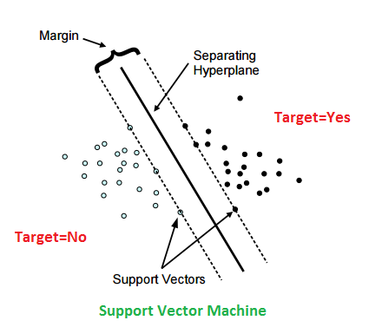
Support Vector Machines Terminologies
Hyperplane
A hyperplane is a decision boundary which separates between given set of data points having different class labels. The SVM classifier separates data points using a hyperplane with the maximum amount of margin. This hyperplane is known as the maximum margin hyperplane and the linear classifier it defines is known as the maximum margin classifier.
Margin in SVM
Support Vectors
Support vectors are the sample data points, which are closest to the hyperplane. These data points will define the separating line or hyperplane better by calculating margins
Margin
A margin is a separation gap between the two lines on the closest data points. It is calculated as the perpendicular distance from the line to support vectors or closest data points. In SVMs, we try to maximize this separation gap so that we get maximum margin.

Slide 4
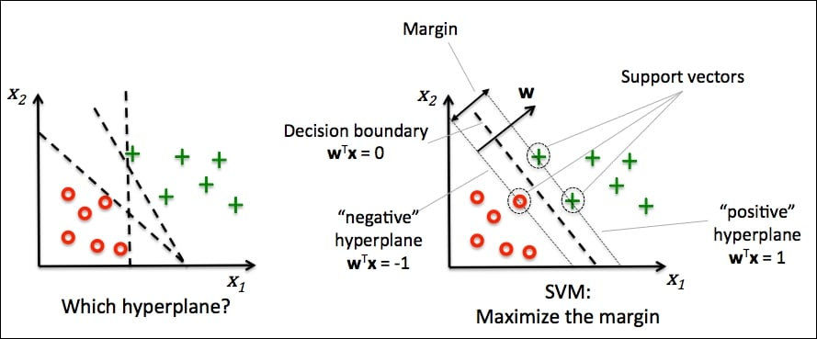
How Does SVM Works
In SVMs, our main objective is to select a hyperplane with the maximum possible margin between support vectors in the given dataset. SVM searches for the maximum margin hyperplane in the following 2 step process –
Generate hyperplanes which segregates the classes in the best possible way. There are many hyperplanes that might classify the data. We should look for the best hyperplane that represents the largest separation, or margin, between the two classes.
So, we choose the hyperplane so that distance from it to the support vectors on each side is maximized. If such a hyperplane exists, it is known as the maximum margin hyperplane and the linear classifier it defines is known as a maximum margin classifier.
The following diagram illustrates the concept of maximum margin and maximum margin hyperplane in a clear manner.

Slide 5
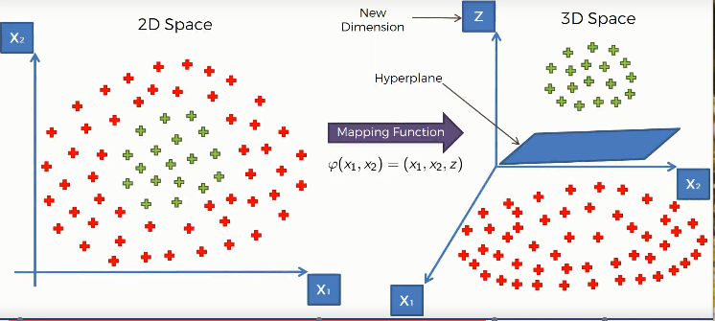
Non-Linear SVM
Sometimes, the sample data points are so dispersed that it is not possible to separate them using a linear hyperplane. In such a situation, SVMs uses a kernel trick to transform the input space to a higher dimensional space as shown in the diagram below. It uses a mapping function to transform the 2-D input space into the 3-D input space. Now, we can easily segregate the data points using linear separation.
Kernel trick - transformation of input space to higher dimensional space

Slide 6
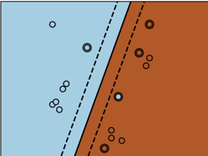
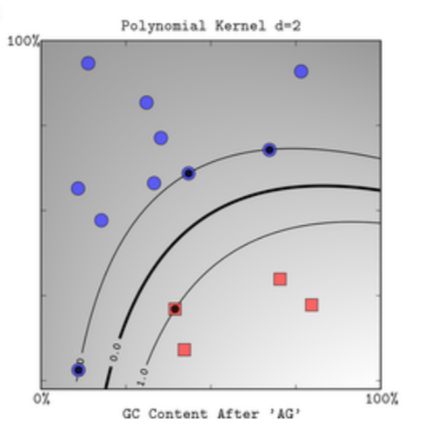

Kernel Functions
Linear
These are commonly recommended for text classification because most of these types of classification problems are linearly separable.
The linear kernel works well when there are a lot of features, and text classification problems have a lot of features. Linear kernel functions are faster than most of the others and you have fewer parameters to optimize.
Here's the function that defines the linear kernel:
In this equation, w is the weight vector that you want to minimize, X is the data that you're trying to classify, and b is the linear coefficient estimated from the training data. This equation defines the decision boundary that the SVM returns.
Polynomial
The polynomial kernel isn't used in practice very often because it isn't as computationally efficient as other kernels and its predictions aren't as accurate.
Here's the function for a polynomial kernel:
This is one of the simple polynomial kernel equations you can use. f(X1, X2) represents the polynomial decision boundary that will separate your data. X1 and X2 represent your data.

Slide 7


Kernel Functions
Gaussian Radial Basis Function (RBF)
One of the most powerful and commonly used kernels in SVMs. Usually the choice for non-linear data.
Here's the equation for an RBF kernel:
In this equation, gamma specifies how much a single training point has on the other data points around it. ||X1 - X2|| is the dot product between your features.
Sigmoid
More useful in neural networks than in support vector machines, but there are occasional specific use cases.
Here's the function for a sigmoid kernel:
In this function, alpha is a weight vector and C is an offset value to account for some mis-classification of data that can happen.

Slide 8
Tuning Hyperparameters
Kernel: The main function of the kernel is to transform the given dataset input data into the required form. There are various types of functions such as linear, polynomial, and radial basis function (RBF). Polynomial and RBF are useful for non-linear hyperplane. Polynomial and RBF kernels compute the separation line in the higher dimension. In some of the applications, it is suggested to use a more complex kernel to separate the classes that are curved or nonlinear. This transformation can lead to more accurate classifiers.
Regularization: Regularization parameter in python's Scikit-learn C parameter used to maintain regularization. Here C is the penalty parameter, which represents misclassification or error term. The misclassification or error term tells the SVM optimization how much error is bearable. This is how you can control the trade-off between decision boundary and misclassification term. A smaller value of C creates a small-margin hyperplane and a larger value of C creates a larger-margin hyperplane.
Gamma: A lower value of Gamma will loosely fit the training dataset, whereas a higher value of gamma will exactly fit the training dataset, which causes over-fitting. In other words, you can say a low value of gamma considers only nearby points in calculating the separation line, while the a value of gamma considers all the data points in the calculation of the separation line.

Slide 9
Pros
Effective on datasets with multiple features, like financial or medical data.
Effective in cases where number of features is greater than the number of data points.
Uses a subset of training points in the decision function called support vectors which makes it memory efficient.
Different kernel functions can be specified for the decision function. You can use common kernels, but it's also possible to specify custom kernels.
Cons
If the number of features is a lot bigger than the number of data points, avoiding over-fitting when choosing kernel functions and regularization term is crucial.
SVMs don't directly provide probability estimates. Those are calculated using an expensive five-fold cross-validation.
Works best on small sample sets because of its high training time.

